Slide 1

Vector Space Learning

Slide 2
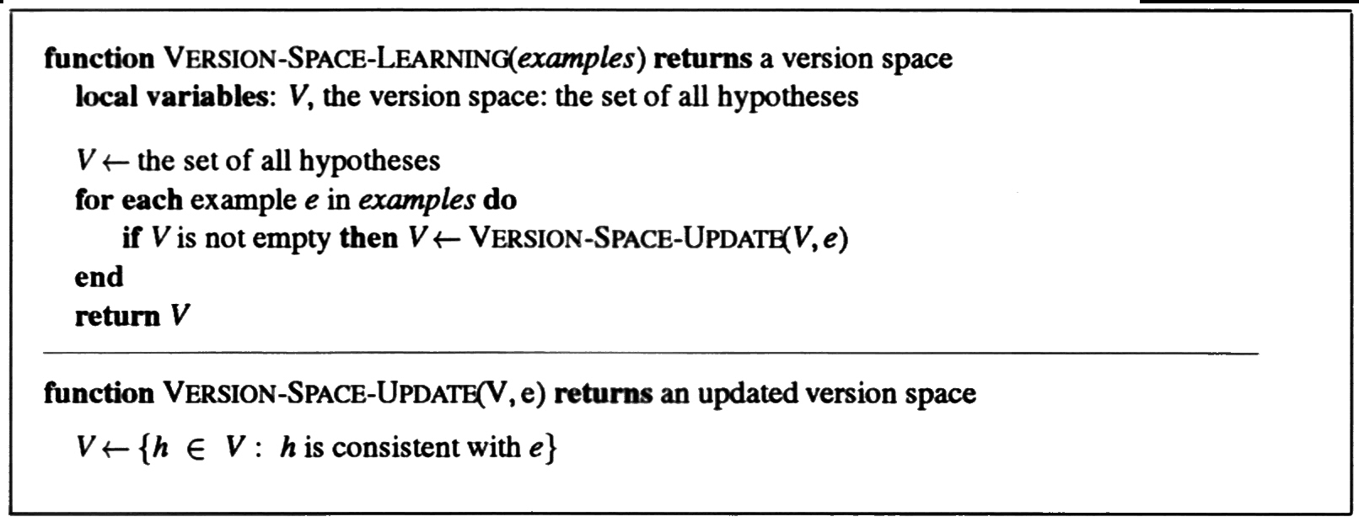
Case study : Version Space Learning
A Logical Formulation
of Learning
Least commitment:
Instead of keeping around one hypothesis and using backtracking, keep all consistent hypotheses (and only those).
Incremental: old instances do not have to be rechecked

Slide 3
Version Space Learning
A Logical Formulation
of Learning
No need to list all consistent hypotheses:
Keep - most general boundary (G-Set)
- most specific boundary (S-Set)
Everything in between is consistent.
Everything outside is inconsistent.
Initialize: G-Set={True}
S-Set={False}

Slide 4
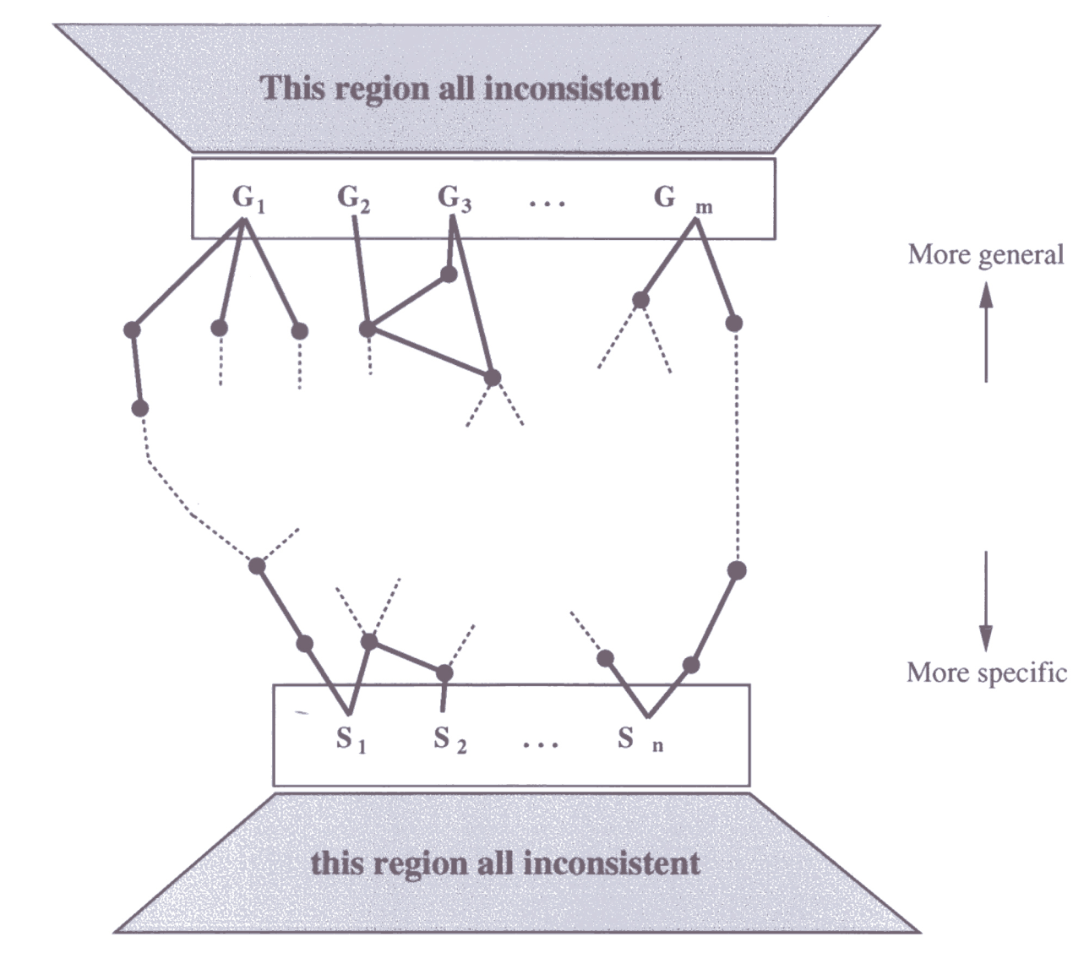
Version Space Learning
A Logical Formulation
of Learning
Algorithm:
1. False positive for Si:
Si is too general, and there are no consistent specializations for Si,
so throw Si out of S-Set
2. False negative for Si:
Si is too specific,
so replace it with all its immediate generalizations.
3. False positive for Gi:
Gi is too general,
so replace it with all its immediate specializations.
4. False negative for Gi:
Gi is too specific, but there are no consistent generalizations of Gi,
so throw Gi out of G-Set

Slide 5
Version Space Learning
A Logical Formulation
of Learning
One concept left
S-set of G-Set becomes empty, i.e. no consistent hypothesis.
No more training examples, i.e. more than one hypothesis is left.
Problems:
If there is noise or insufficient attributes for correct classification, the version space collapses.
If we allow unlimited disjunction, then
S-Set will contain a single most specific hypothesis, i.e., the disjunction of the positive training examples.
G-set will contain just the negation of the disjunction of the negative examples.
- Use limited forms of disjunction
- Use generalization hierarchy
e.g. WaitEsitmate(x,30-60)∨WaitEstimate(x,>60) → LongWait(x)

Slide 6
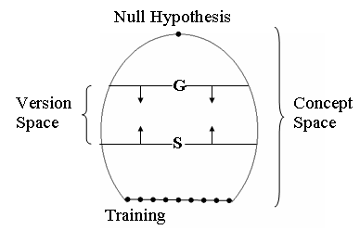
A Logical Formulation
of Learning
Version Space Concept

Slide 7
An Concept and Version Spaces
A Logical Formulation
of Learning
At the top of the concept space is null description, consisting only of variables.
At the bottom are all of the possible training instance, which contain no variable.
Before receive any training examples, the target concept lies somewhere in the concept space.
If every possible description is an instance of the intended concept, then null description is the concept definition since it matches everything.
If the target concept includes only a single example, then one of the descriptions at the bottom of the concept space is the desired concept definition.
Most target concepts, of course, lie somewhere in between these two extremes.

Slide 8
How can we represent the Version Spaces
A Logical Formulation
of Learning
Version Space consists two subsets of the concept space.
G contains the most general descriptions consistent with the training examples.
S contains the most the most specific description consistent with the training examples.
The version space is the set of all descriptions that lie between some element of G and element of S in the partial order of the concept space.
Positive training is to make the S set more general
Negative training is to make the G set more specific
If the S and G set converge, our range hypotheses will narrow to a single concept description.
The algorithm for narrowing the version space is called the candidate elimination algorithm.

Slide 9
Specific to General Search Algorithm
A Logical Formulation
of Learning
Begin
Initialize S to the first pos. training instance
For each positive instance p:
If s doest not match p, replace s with its most specific generalization that match p
For each negative instance n:
Delete all members of s that match n
9

Slide 10
Specific to General
Search Algorithm
Version spaces search (S to G) for concept “Ball”
S : { }
Pos : obj(small,red,ball)
Initialize S to the first pos. training instance
S : {obj(small,red,ball) }

Slide 11
Specific to General
Search Algorithm
Version spaces search (S to G) for concept “Ball”
S : { }
Pos : obj(small,red,ball)
Initialize S to the first pos. training instance
S : {obj(small,red,ball) }
Pos : obj(small,white,ball)
If s doest not match p, replace s with its most specific
generalization that match p
S : {obj(small,X,ball) }

Slide 12
Specific to General
Search Algorithm
Version spaces search (S to G) for concept “Ball”
S : { }
Pos : obj(small,red,ball)
Initialize S to the first pos. training instance
S : {obj(small,red,ball) }
Pos : obj(small,white,ball)
If s doest not match p, replace s with its most specific
generalization that match p
S : {obj(small,X,ball) }
Pos : obj(large,red,ball)
If s doest not match p, replace s with its most specific
generalization that match p
S : {obj(Y,X,ball) }

Slide 13
A Logical Formulation
of Learning
General to Specific Search Algorithm
Begin
Initialize G to contain the most general concept in the space
For each negative instance n:
For each g that match n, replace g with its most general specialization that do not match n
For each positive instance p:
Delete from G all hypotheses that fail to match p
13

Slide 14
General to Specific
Search Algorithm
Version spaces search (G to S) for concept “Ball”
G : { obj(X,Y,Z) }
Neg : obj(small,red,brick)
For each g that match n, replace g with its most general specialization
that do not match n
G : {obj(large,Y,Z), obj(X,white,Z), obj(X,blue,Z),
obj(X,Y,ball), obj(X,Y,cube)}

Slide 15
General to Specific
Search Algorithm
Version spaces search (G to S) for concept “Ball”
G : { obj(X,Y,Z) }
Neg : obj(small,red,brick)
For each g that match n, replace g with its most general specialization
that do not match n
G : {obj(large,Y,Z), obj(X,white,Z), obj(X,blue,Z),
obj(X,Y,ball), obj(X,Y,cube)}
Pos : obj(large,white,ball)
Delete from G all hypotheses that fail to match p
G : {obj(large,Y,Z), obj(X,white,Z), obj(X,Y,ball)}

Slide 16
General to Specific
Search Algorithm
Version spaces search (G to S) for concept “Ball”
G : { obj(X,Y,Z) }
Neg : obj(small,red,brick)
For each g that match n, replace g with its most general specialization
that do not match n
G : {obj(large,Y,Z), obj(X,white,Z), obj(X,blue,Z),
obj(X,Y,ball), obj(X,Y,cube)}
Pos : obj(large,white,ball)
Delete from G all hypotheses that fail to match p
G : {obj(large,Y,Z), obj(X,white,Z), obj(X,Y,ball)}
Neg : obj(large,blue,cube)
For each g that match n, replace g with its most general specialization
that do not match n
G : {obj(large,white,Z), obj(X,white,Z), obj(X,Y,ball)}

Slide 17
General to Specific
Search Algorithm
Version spaces search (G to S) for concept “Ball”
G : { obj(X,Y,Z) }
Neg : obj(small,red,brick)
For each g that match n, replace g with its most general specialization
that do not match n
G : {obj(large,Y,Z), obj(X,white,Z), obj(X,blue,Z),
obj(X,Y,ball), obj(X,Y,cube)}
Pos : obj(large,white,ball)
Delete from G all hypotheses that fail to match p
G : {obj(large,Y,Z), obj(X,white,Z), obj(X,Y,ball)}
Neg : obj(large,blue,cube)
For each g that match n, replace g with its most general specialization
that do not match n
Pos : obj(small,blue,ball)
G : {obj(large,white,Z), obj(X,white,Z), obj(X,Y,ball)}
Delete from G all hypotheses that fail to match p
G : {obj(X,Y,ball) }

Slide 18
Candidate Elimination
Algorithm
Given : A representation language and a set of positive and negative examples expressed in that language.
Compute : A concept description that is consistent with all the positive examples and none of the negative examples.
Initialize G to contain one element : the null description (all features are variables).
Initialize S to contain one element : the first positive example.

Slide 19
Candidate Elimination
Algorithm
3. Accept a new training example.
If it is a positive example, first remove from G any descriptions that do not cover the example. Then, update the S set to contain the most specific set of descriptions in the version space that cover the example and the current element of the S set. That is, generalize the elements of S as little as possible so that they cover the new training example.

Slide 20
Candidate Elimination
Algorithm
If it is a negative example, first remove from S any descriptions that cover the example. Then, update the G set to contain the most general set of descriptions in the version space that do not cover the example. That is, specialize the element of G as little as possible so that the negative example is no longer covered by any of the elements of G.
If S and G are both singleton sets, then if they are identical, output their value and halt. If they are both singleton sets but they are different, then the training cases were inconsistent. Output this result and halt. Otherwise, go to step 3.

Slide 21
Candidate Elimination
Algorithm
G : { obj(X,Y,Z) }, S: { }
Pos : obj(small,red,ball)
Initialize G to be the most general concept in the space, and
Initialize S to the first pos. training instance
G : { obj(X,Y,Z) }, S :{ obj(small, red, ball) }

Slide 22
Candidate Elimination
Algorithm
G : { obj(X,Y,Z) }, S: { }
Pos : obj(small,red,ball)
Initialize G to be the most general concept in the space, and
Initialize S to the first pos. training instance
G : { obj(X,Y,Z) }, S :{ obj(small, red, ball) }
Neg : obj(small,blue,ball)
Delete all members of S that match n
For each g that match n, replace g with its most general specialization
that do not match n
G : { obj(X,red,Z) }, S :{ obj(small, red, ball) }

Slide 23
Candidate Elimination
Algorithm
G : { obj(X,Y,Z) }, S: { }
Pos : obj(small,red,ball)
Initialize G to be the most general concept in the space, and
Initialize S to the first pos. training instance
G : { obj(X,Y,Z) }, S :{ obj(small, red, ball) }
Neg : obj(small,blue,ball)
Delete all members of S that match n
For each g that match n, replace g with its most general specialization
that do not match n
G : { obj(X,red,Z) }, S :{ obj(small, red, ball) }
Pos : obj(large,red,ball)
Delete all members of G that fail to match p
For every s, if s does not match p, replace s with its most specific
generalization that match p
G : { obj(X,red,Z) }, S :{ obj(X, red, ball) }

Slide 24
Candidate Elimination
Algorithm
G : { obj(X,Y,Z) }, S: { }
Pos : obj(small,red,ball)
Initialize G to be the most general concept in the space, and
Initialize S to the first pos. training instance
G : { obj(X,Y,Z) }, S :{ obj(small, red, ball) }
Neg : obj(small,blue,ball)
Delete all members of S that match n
For each g that match n, replace g with its most general specialization
that do not match n
G : { obj(X,red,Z) }, S :{ obj(small, red, ball) }
Pos : obj(large,red,ball)
Delete all members of G that fail to match p
For every s, if s does not match p, replace s with its most specific
generalization that match p
G : { obj(X,red,Z) }, S :{ obj(X, red, ball) }
Neg: obj(large,red,cube)
Delete all members of S that match n
For each g that match n, replace g with its most general specialization
that do not match n
G : { obj(X,red,ball) }, S :{ obj(X, red, ball) }

Slide 25
Candidate Elimination
Algorithm
G : { obj(X,Y,Z) }, S: { }
Pos : obj(small,red,ball)
Initialize G to be the most general concept in the space, and
Initialize S to the first pos. training instance
G : { obj(X,Y,Z) }, S :{ obj(small, red, ball) }
Neg : obj(small,blue,ball)
Delete all members of S that match n
For each g that match n, replace g with its most general specialization
that do not match n
G : { obj(X,red,Z) }, S :{ obj(small, red, ball) }
Pos : obj(large,red,ball)
Delete all members of G that fail to match p
For every s, if s does not match p, replace s with its most specific
generalization that match p
G : { obj(X,red,Z) }, S :{ obj(X, red, ball) }
Neg: obj(large,red,cube)
Delete all members of S that match n
For each g that match n, replace g with its most general specialization
that do not match n
G : { obj(X,red,ball) }, S :{ obj(X, red, ball) }

Slide 26
Positive and Negative Examples of the Concept “Japanese economy car”
Candidate Elimination
Algorithm
origin : Japan
mfr : Honda
color : Blue
decade : 1980
type : Economy
(+)
origin : Japan
mfr : Toyota
color : Green
decade : 1970
type : Sports
( - )
origin : Japan
mfr : Toyota
color : Blue
decade : 1990
type : Economy
( + )
origin : USA
mfr : Chrysler
color : Red
decade : 1980
type : Economy
( - )
origin : Japan
mfr : Honda
color : White
decade : 1980
type : Economy
( + )

Slide 27
A Version Space Example
Candidate Elimination
Algorithm
G = {(x1,x2,x3,x4,x5)}
S = {(Japan, Honda, Blue, 1980, Economy)}
G = {(x1, Honda,x3,x4,x5) ,(x1,x2,Blue,x4,x5), (x1,x2,x3,1980,x5),(x1,x2,x3,x4,Economy)}
S = {(Japan, Honda, Blue, 1980, Economy)}
G = {(x1,x2, Blue, x4,x5), (x1,x2,x3,x4,Economy)}
S = {(Japan, x2, Blue, x4, Economy)}
G = { (Japan,x2, Blue,x4,x5),(Japan,x2,x3,x4, Economy)}
S = {(Japan,x2, Blue,x4, Economy)}
G = {(Japan,x2,x3,x4,Economy)}
S = {(Japan,x2,x3,x4,Economy)}

Slide 28
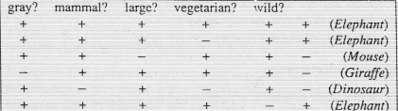
Exercises : How About The Concept of Elephant ?
Candidate Elimination
Algorithm

